Slide 1
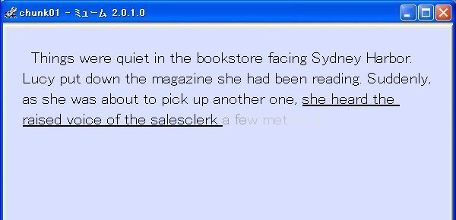
Integration of Classroom Practice and Effect Measurement on CALL on software
Akinobu KANDA（Tokyo Metropolitan University）
Ryuji TABUCHI（Mint Sound Education Group）
Takane YAMAGUCHI（Waseda University）
Eiichi YUBUNE（Toyo University）
November 22, 2014 Asia CALL
Notes:
In a CALL environment, Since 2007, we have been trying to enhance reading efficiency (RE) of Japanese university learners of English by using fast-reading training software with a chunking text on a PC display. In this presentation, we will explain the effect of the software used in actual classes in the past research, and then, showing a renovated software with some results this year.

Slide 2
Reading Efficiency (RE)
・ RE= WPM*✕success rate of reading comprehension
RE 125 = WPM125 times 100% (all items are correct)
RE 100 = WPM125 time 80% (4/5 items are correct)
RE 100 = WPM100 times 100% (all items are correct)
*WPM=Words Per Minute
Notes:
Before the main story, let me just stop to explain the terminology. We say Reading Efficiency as WPM multiplied by success rate of reading comprehension. So RE indicates how fast and accurate you can read.

Slide 3
Overview
Why chunks?
Effect of Dynamic Display Mode of Chunks on a Software
Methodology and Challenges
Renovated Software
Learners’ Voice
Conclusion
Notes:
I’ll tell you why we focused on a chunk in a reading activity.
… the effect of dynamic display mode of chunks on a certain software in our past study
… How we conducted the research in the actual classes and then we refer to the challenges we have met.
As solution to the challenges, we demonstrate a renovated software of dynamic display mode of chunks.
Show you the result of one example of use of the software this year.

Slide 4
１.Why Chunks?
A chunk ＝ minimum unit of sound, meaning, and syntax
  5 to 7 words in one chunk with a duration of 2±1 sec.
By chunks …processing meaning & syntax in the word order of English
Sustainable effectual factor for enhancing reading speed and efficiency by displaying mode of chunks
Notes:
So, first of all, let me just begin with a chunk itself: Why we have focused on a chunk reading. I have to make sure what a chunk is: A chunk is a minimum unit of sound, meaning, and syntax with approximately 5 to 7 words in one chunk with a duration of 2±1 sec.
According to prior studies shown in the references, this unit of chunk enables learners to process the meaning and structure of English sentences. Another study shows that a display method of chunked phrases and clauses could significantly enhance reading speed.
So we assume that a chunk is a sustainable effectual factor….

Slide 5
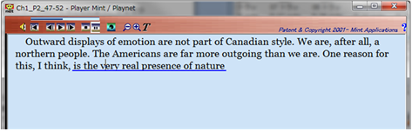
2. Effect of Dynamic Display Mode in the Software
Player Mint (Mint applications Co.LTD)
One chunk after another appearing and staying with a synchronized native speaker’s reading voice
Notes:
Then, Why we turn to software? We have assumed that using chunking texts on a PC display would be effective for novice Japanese learners of English ; they tend to read an English sentence back and forth in order to parse it and translate it into Japanese, word for word. The dynamic chunking displaying mode(図の説明） propels and forces learners to read straight along the lines. Or we think that, in order to acquire reading efficiency, learners should put priority on just speed-up rather than accuracy.

Slide 6
3.1 Methodology
Training in a lesson (Treatment)
  One time(5 minutes) per week on 4-month semester basis
Fast reading on Mint, and online comprehension quizzes
  Instant feedback of WPM and comprehension score separately
Afterwards, reading a paper textbook, based on chunk-reading, or Oral reading using the software
Notes:
How we used Mint and train students in the treatment.
We gave student a training in an actual lesson , each training takes about 5minitues or so per week on 4-month semester basis.
The training consisted of Fast reading on Mint and online comprehension quizzes on LMS(Moodle). Instant feedback of WPM and comprehension score can be given from these different tools. But feedback may motivate students and become a pacemaker of their reading
After the reading practice, we gave a usual reading class on paper base based on the instruction of chunk-reading, or gave oral reading practice

Slide 7
3.1 Methodology
  Pre- and Post-Test （effect measurement）
  At the beginning and end of each semester,
Timed-Reading test (approx. four 300-word passages with 5 comprehension quizzes in each) within 20 minutes
20 Listening quizzes
Notes:
For effect measurement , we gave pre- and posttest.
20mins listening quizzes aims to measure the transfer effect of reading to listening.
These tests are adopted from Japanese English Practical English Proficiency Test pre-2 Level, which is well-known and general for Japanese students.

Slide 8
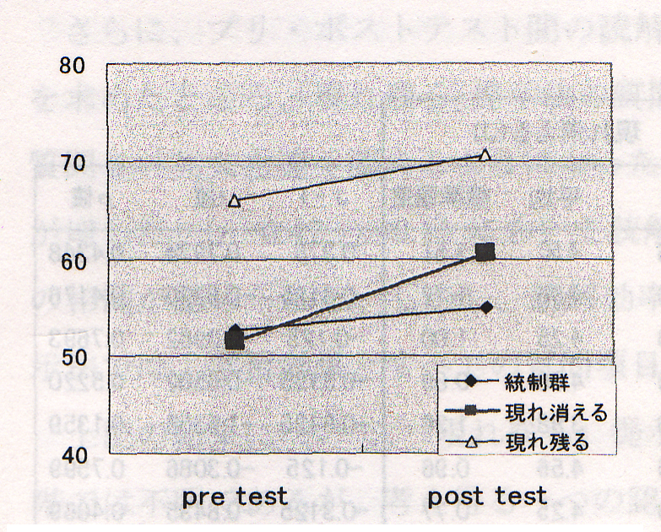
A Typical Result of Pre- &Post-test (Yubune et al 2009)
Controlled group
Mode of appear & disappear
Mode of appear
Notes:
Yubune, Kanda, Tabuchi(2009)
All those groups (lower level) are rising in reading efficiency (In reality, there were two experimental groups of different displaying mode. but now I don’t detail it for expediency)

Slide 9

3.2 Challenges
Precision of measurement of WPM
Difficulty in data-tallying
Necessity of instant feedback
Separation of the environments of pre- & post-tests and trainings
Notes:
Despite such a result, we saw challenges on how we do the research. For one thing, in pre- and post tests, we had difficulty measuring WPM and comprehension rate precisely; for example, we had, at one time without Mint, at other times on paper base, used multiple tools like HTML, a stop-watch, and a bubble sheet. That made it difficult to tally the data and give a quick feedback.
For another, as above, the environment of effect measurement is different from that of training in a lesson. So we have to integrate both as much as possible. In so doing, we may have more data to confirm the effect. The effect measurement has to be taken from the practice of every lesson in a classroom.
Thus there arises a need to upgrade or renovate the software for sustainable practice.

Slide 10
4.1 Renovated Software: Mewm
What is Mewm?
Software
  for measuring readers’ speed and accuracy.
  and for motivating learners.
Notes:
As mentioned by Prof. Kanda, we needed to measure the learners’ reading speed and accuracy more precisely and easily.
So Mr. Tabuchi created a new software, Mewm. If you use this software, you can make your learners read any passages you want them to read, and you’ll be able to know how well they have read the passages. And you may expect to motivate learners.

Slide 11
4.2 How to use Mewm: 3 steps
1st : Creation of reading materials for learners
2nd : Measurement of Reading Speed and Accuracy
3rd: Summarization of Learners’ Data
Notes:
There are three steps for accurate and easy measurement: 1st: Creation of reading materials for learners;
2nd : After learners have finished their reading passages and answering the questions, you can measurement Learners’ Reading Speed and Accuracy;
3rd : the Summarization of Learners’ Data.
In the 1st step, you can convert the passage data, into a Mewm file, if you have a text style file.

Slide 12

2nd step: Measurement of Reading Speed and Accuracy
Notes:
In the second step, learners read passages and answer the questions on their PC and at the same time Mewm is watching and recording learners’ time to read and their answers.

Slide 13
4.3 2nd step: learners read passages
2-1 read precautions
2-2 type your name
2-3 read a passage and answer quizzes
2-4 see your result
2-5 send the result file automatically
2-6 see the results of all the learners
Notes:
In the 2nd step, your learners read passages you have prepared. The second step has 6 stages. Now, I’m going to read as a learner on the Mewm file. First, you read basic precautions such as “you will have to read speedily and accurately” Second, you type your name; Third, you read a passage and answer its quizzes. 4th you see your individual reading results Fifth: your file on the results is sent automatically to your teacher. Finally you’ll see the results of all the learners in a class, of course including your result.
Now, I’m going to demonstrate the 2nd step as a learner.

Slide 14
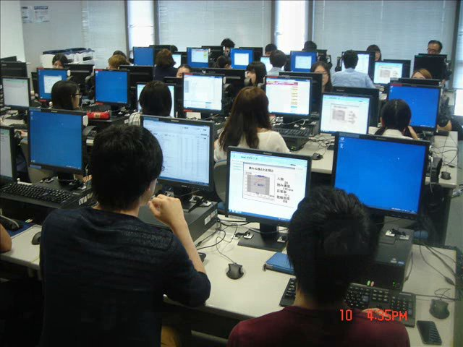
Step 2-6
Notes:
This slide shows learners have finished reading, and they are now watching the results of all the learners.

Slide 15
4.3 step 2-6: all the results in a class
Notes:
On the stage 2-4, learners can look at the result screen about all the learners in a classroom after reading. This is an example screen. Dots stand for individual results. You see one learner got 100% of accuracy. She or he read passages at the speed of about 80 WPM. Look at the bottom. There are 6 learners whose reading speeds are different, but all of them did not answer any question correctly. We thought it would be beneficial for learners to look at all the learners’ results after reading . Now I’ll show you a short video about the feedback in a classroom. This is a monitor screen. Two learners have finished their reading. Both learners read at the speed of 200 WPM,; the horizontal line shows WPM. One learner answered correctly 100% while the other 50%. The number of the dots is increasing, because the Mewm system collects learners’ data as soon as learners finish reading. Finally the screen shows Mewm collected 25 learners’ data.

Slide 16
4.4 3rd step: Summarization of Data
3-1 start the application, Mewm
3-2 drug and drop the files to the app.
3-3 copy the data
3-4 paste the information to an Excel file.
Notes:
In the final step, as a teacher or researcher, I’m going to show you the process of the summarization of the learners’ data.
Probably it’ll take about 30 seconds to paste learners’ data on an Excel file.

Slide 17


4.5 3rd step: Summarized Data
Notes:
This is an example of learners’ summarization. In the column A, the title of the reading material is shown. In the column B, you see your students’ name,. In this case, A, B and C. Time is the total time for reading and answering questions. In the column E, you can see the word number of the first passage. In the column F, you can see 196, which means the number of words in the passage 2. In the column G and H, you’ll see RT. RT means reading time. Learner A took 98 seconds for passage 1. In the column I, you’ll see about 103, which means the learner A’s WPM. In the column K, you’ll see the learner A chose answer 3. In the column M, you’ll see the number 1, which means the answer 3 is correct.

Slide 18
5. Learners’ voice
What do you think of Mewm?
Good | Bad
Write down, please.
Notes:
From now, I report learners’ voice. After we collected their opinions, we categorized them into good or bad comments.

Slide 19
5.1 Learners instantly find their results.
"Immediately after I finish the questions, I saw my result of reading speed and comprehension. It's great!“ (Good)
"I read passages at my own speed so that I felt easy and I found my reading speed.“ (Good)
Notes:
Many Japanese students are very carefully about their friends' actions and results, like on reading scores. This student felt easy because he didn't have to read faster in order to catch up with their friends.

Slide 20
5.2 Learners read by chunks.
"I became aware of the importance of not turning back from the end part of the sentence toward the left while reading English." (Good)
"I found it uneasy to read the gist of a passage within a few seconds" (Good or Bad?)
"I have to understand passages by getting a small unit of chunks, so I sometimes nearly forget what I understand in the text." (Good or Bad?)

Slide 21
5.3 Learners have to read fast.
"I am motivated because Mewm shows me my result of reading speed and comprehension. I have to concentrate on reading, but this enabled me to train my concentration in reading." (Good)
"I don't think I can get the accurate result of my reading because I have to read fast as well as accurately." (Bad)

Slide 22
5.4 Feedback to the whole class
"It’s good that I can find where I am in the class in terms of reading abilities." (Good)
"I can see other results than my result of WPM and reading accuracy." (Good)

Slide 23
6. Conclusion
The Player Mint and the Mewm system
for both learners and teachers
the information on Mewm: http://mintap.kir.jp/public/mewm/
Notes:
We have developed the Mewm system and, thanks to the application, now we do not have to spend a lot of time and effort measuring and collecting learners’ data, even if its amount is more than one hundred. CALL programs are not all about language learning, but the two application programs we have mentioned in this paper have far more advantages than painful, manual labours, for both learners and teachers, such as motivation of learners and the automation of the measurement and collection of learners’ traces. Thus, on these technological bases, reading practice using a chunking text can be useful in order to enhance reading efficiency.

