Slide 1


Movie scene corpus for language learning
Eiichi Yubune (Toyo University),
Ryuji Tabuchi (Mint Applications),
Akinobu Kanda (Tokyo Metropolitan University),
Takane Yamaguchi (Waseda University)

Slide 2
1. Seleaf: Features and Specifications http://www.mintap.com
Is a cloud-based search engine for a tagged corpus of spoken English along with its video pictures from movies.
stores 20 hours of 20 premier movies, which are broken down into 30,000 scenes, 20,000 phrases, and 130,000 words.
enables you to search movie scenes by its script: text data are stored in such a way as to be synchronized with their speech data and visual information.
English transcription and the Japanese subtitles can be switched on an off.
Each word is lemmatized: e.g. the search word go leads you to go, went, gone, goes and going

Slide 3
2. Academic Use of Seleaf
spoken English based on 20 movies from the both continents.
Approximately 20,000 phrases phrase were cut out by pause-detecting program using the default value 100 msec.
the average number of words per phrase is 6.1 words and the average duration is 1.92 seconds:
almost parallel to the reported time constraints for language processing such as the working memory and its supposed phonological loop (Baddeley, 1992; 2000).
The Drill section provides valuable data about the learners’ error behaviour.

Slide 4
Table 1. Linguistic Data broken down by movies
 | Movie Title | N of phrases | Average number of words per phrase | Average duration in msec.
1 | Gone with the Wind | 3,943 | 6.6 | 1,958
2 | Citizen Kane | 2,084 | 6.1 | 1,940
3 | Roman Holiday | 1,494 | 5 | 1,789
4 | Rebecca | 2,264 | 7 | 1,901
5 | Lassie | 1,061 | 5.6 | 1,803
6 | Sharade | 1,719 | 6.2 | 1,961
7 | King Kong | 1,043 | 6 | 1,724
8 | Carmen | 1,045 | 6.8 | 2,033
9 | Casablanca | 2,130 | 6 | 1,685
10 | The Wizard of Oz | 1,668 | 5.9 | 2,212
11 | Arabian Nights | 1,100 | 5.9 | 2,112

Slide 5

3. Educational Use of Seleaf
To present movie scenes to show how a particular word or phrase is used in conversational settings.
To demonstrate examples of how phonetic features of English are realized (along with the speakers’ mouth movement and facial expressions). To help learners improve word recognition and speech rhythm.
Seleaf as a motion picture
dictionary for individual learners.
languge usage and pragmatic use
bookmark function
Notes:
Seleaf provides various resources for language education, academic research and entertainment, but in particular, it is most useful for language education and autonomous learning.
This practice offers sufficient contextual information as a fundamental condition for natural vocabulary and grammar learning to take place. Seleaf has an advantage over DVDs with their random access and replayable feature, which is useful in creating language games DVD; otherwise, teachers must prepare video clips for each scene before class.

Slide 6
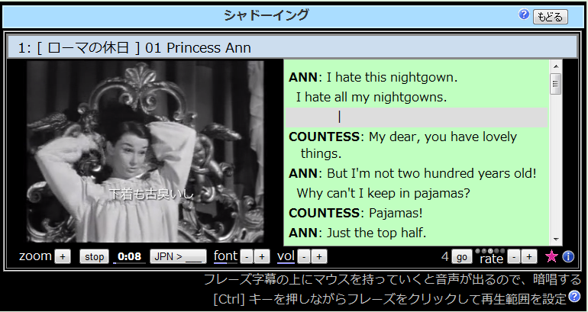
4. Educational Use: Seleaf Drill
Shadowing section helps learners to read aloud or shadow-read any phrases repeatedly.

Slide 7
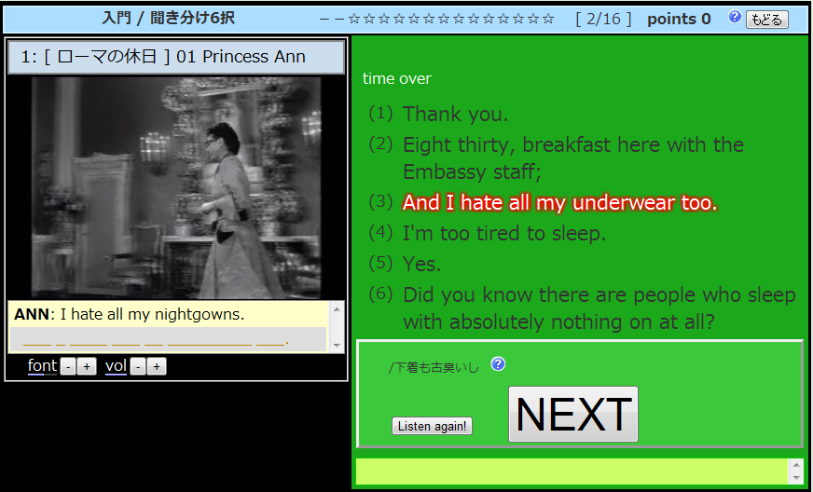
4. Educational use: Listening & Dictation section

Slide 8
Data from the Drill section

Slide 9
Error logs from the Drill section

Slide 10
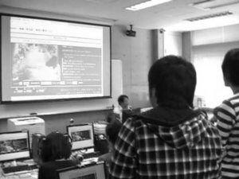
4. Educational use: role-playing
A particular actors’ voice can be cut off so that students can work on role-playing exercise.

Slide 11
5. Experiment
Purpose:
To measure the learning outcome of classroom training through Seleaf.
Method:
- Second year Japanese college students (n=18) studied by Seleaf for 20 minutes every week for 4 months.
Pre and Post test were carried out using Standardized Test for English Proficiency (STEP) semi-second level listening test (20 short conversations and monologues with multiple choice comprehension questions).

Slide 12
5. Experiment (2)
Results:
The average score increased from 14.5 to 16.3 (t(17)=2.11, p<0.01, d=0.96).

Slide 13
5. Experiment (3)
The relationships between Pre-and-post test results and study hours were analyzed.
The diameter of a circle represents the total amount of study hours.
A middle level correlation was found between the study hours and test score gains (r= .45).

Slide 14
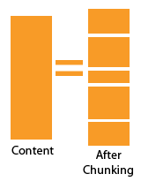
5. Experiment (5): questionnaire (2)
16 Five-point Likert-scale questionnaires at the pre and the post tests.
A significant increase in the questionnaire item “I’m listening while being aware of the sense group (chunks).” (+0.6 up; Z=1.92, p<0.05, r=0.45, Wilcoxon signed rank test).
U S A L M S H N B C J A L
USA LMS HNBC JAL

Slide 15
Score gains in the questionnaire

Slide 16


5. Experiment (4): questionnaire
A slight increase in some other questionnaire item (+0.3 up; no statistical significance).
“Listening is fun.”
“I do not turn back while reading.”
“I do not translate while reading.”

Slide 17
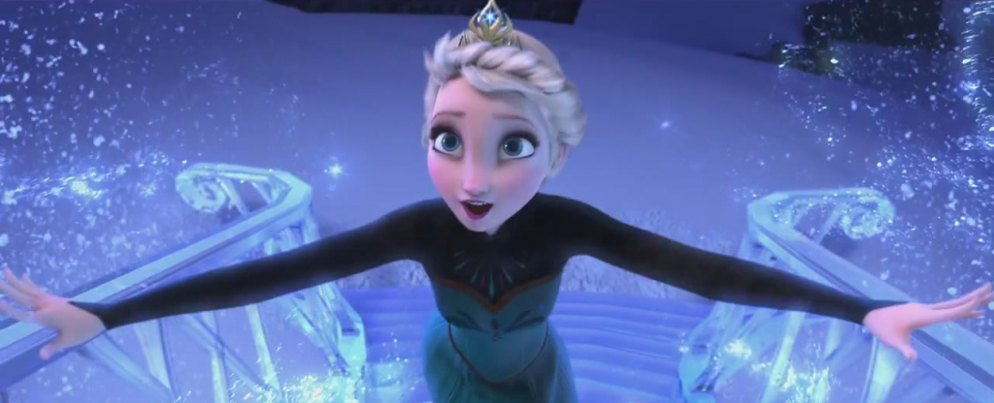
6. Conclusion
A training method where learners try to connect the sound and written scripts on the basis of breath groups may improve their overall listening comprehension,
as well as increase their motivation of learning English through listening training.

Slide 18
References
Baddeley, A.D. (1992). Working Memory. Science, 255, 5044, 556–559.
Baddeley, A.D. (2000). The Episodic Buffer: A New Component of
Working Memory? Trends in Cognitive Sciences, 4, 421.

